Slide 1
SORTED LIST

Slide 2
What is HashSet<T> Collection
The Generic SortedList<TKey, TValue> Collection Class in C# represents a collection of key/value pairs that are sorted by the keys based on the associated IComparer implementation. By default, it sorts the key/value pairs in ascending order. For example, if the keys are of primitive data types, then it sorted the collection in ascending order of keys, and if the keys are of string type, then it will sort the element alphabetically.
With the help of a key, we can easily search for or remove elements from the SortedList collection. The generic SortedList collection can be accessible either by using the keys or by using the integral index.
SortedList<TKey, TValue> Collection allows us to store duplicate values, but the keys must be unique and cannot be null

Slide 3
CREATE a SortedList<Tkey, Tvalue> Collection
SortedList(): It initializes a new instance of the System.Collections.Generic.SortedList class that is empty, has the default initial capacity, and uses the default System.Collections.Generic.IComparer
SortedList(IComparer<TKey> comparer): It initializes a new instance of the System.Collections.Generic.SortedList class that is empty, has the default initial capacity and uses the specified System.Collections.Generic.IComparer. The Parameter comparer specifies the System.Collections.Generic.IComparer implementation to use when comparing keys. -or- null to use the System.Collections.Generic.Compare for the type of the key.
SortedList(IDictionary<TKey, TValue> dictionary): It initializes a new instance of the System.Collections.Generic.SortedList class that contains elements copied from the specified System.Collections.Generic.IDictionary, has sufficient capacity to accommodate the number of elements copied and uses the default System.Collections.Generic.IComparer. The Parameter dictionary specifies the System.Collections.Generic.IDictionary whose elements are copied to the new System.Collections.Generic.SortedList.
SortedList(int capacity): It initializes a new instance of the System.Collections.Generic.SortedList class that is empty, has the specified initial capacity and uses the default System.Collections.Generic.IComparer. The Parameter capacity specifies the initial number of elements that the System.Collections.Generic.SortedList can contain.
public SortedList(IDictionary<TKey, TValue> dictionary, IComparer<TKey>? comparer): It initializes a new instance of the System.Collections.Generic.SortedList class that contains elements copied from the specified System.Collections.Generic.IDictionary, has sufficient capacity to accommodate the number of elements copied and uses the specified System.Collections.Generic.IComparer. The Parameter comparer specifies the System.Collections.Generic.IComparer implementation to use when comparing keys. -or- null to use the default System.Collections.Generic.Comparer for the type of the key. The Parameter dictionary specifies the System.Collections.Generic.IDictionary whose elements are copied to the new System.Collections.Generic.SortedList.
SortedList(int capacity, IComparer<TKey>? comparer): It initializes a new instance of the System.Collections.Generic.SortedList class that is empty, has the specified initial capacity and uses the specified System.Collections.Generic.IComparer. The Parameter comparer specifies the System.Collections.Generic.IComparer implementation to use when comparing keys. -or- null to use the default System.Collections.Generic.Comparer for the type of the key. The Parameter capacity specifies the initial number of elements that the System.Collections.Generic.SortedList can contain.

Slide 4
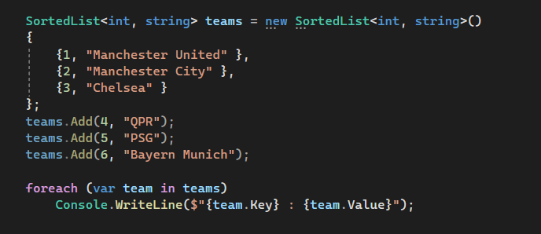

How to Add Elements into a Generic SortedList Collection
If you want to add a key/value pair to a Generic SortedList Collection, then you need to use the Add() method provided by the Generic SortedList class.
Add(TKey key, TValue value): The Add(TKey key, TValue value) method is used to add an element with the specified key and value into the Generic SortedList. Here, the parameter key specifies the key of the element to add and the parameter value specifies the element to add. The value can be null for reference types. If the key is null, then it will throw ArgumentNullException and if an element with the same key already exists in the Generic SortedList, then it will throw ArgumentException

Slide 5
How to Access a Generic SortedList Collection
We can access the key/value pairs of the Generic SortedList Collection in C# using three different ways.
Using for loop to access Generic SortedList Collection
As the SortedList Collection has the Indexer, so, you can use a for loop to access the key/value pairs as shown below.
Using Index to Access Generic SortedList Collection
You can access the individual value of the Generic SortedList Collection in C# by using the index. In this case, we need to pass the key as a parameter to find the respective value.
Using for-each loop to access Generic SortedList Collection
You can also use a for-each loop to access the key/value pairs of the Generic SortedList Collection

Slide 6
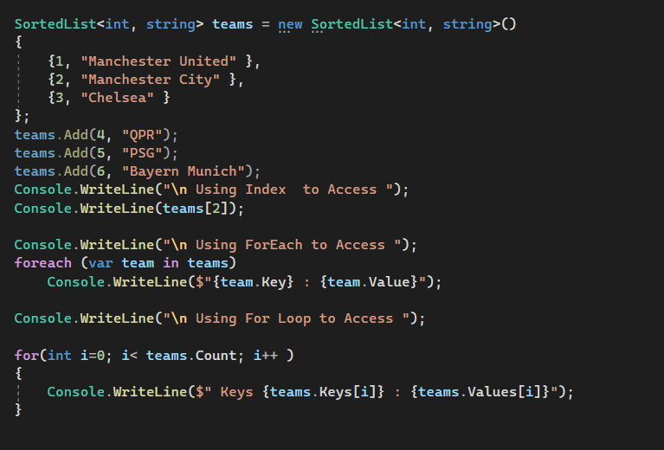


Slide 7
How to Remove Elements from a Generic SortedList Collection
The Generic SortedList Collection Class in C# provides the following methods to remove elements from SortedList.
Remove(TKey key): This method is used to remove the element with the specified key from the System.Collections.Generic.SortedList. The parameter key specifies the element to remove. It returns true if the element is successfully removed; otherwise, false. This method also returns false if the key was not found in the original Generic SortedList.
RemoveAt(int index): This method is used to remove the element at the specified index of a Generic SortedList. The parameter index specifies the element to remove. It is 0 based Index.
Clear(): This method is used to remove all elements from a Generic SortedList Collection.

Slide 8
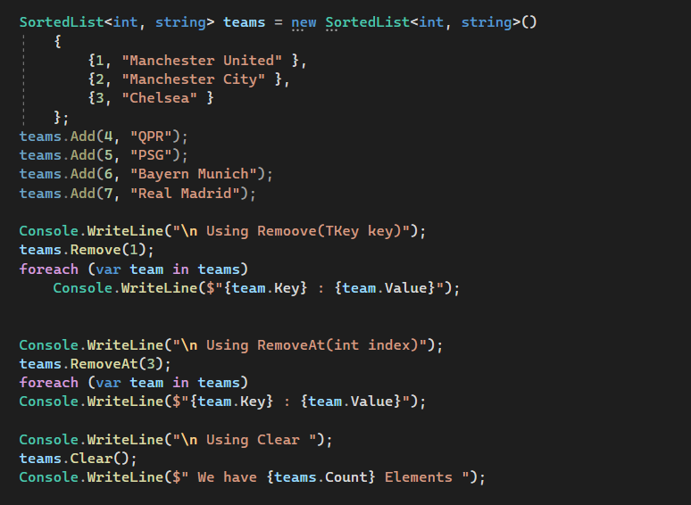
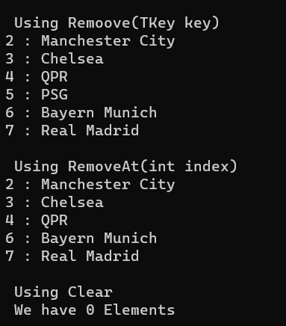

Slide 9
How to check the Availability of key/value Pairs in a Generic SortedList Collection
If you want to check whether the key/value pair exists or not in the Generic SortedList Collection in C#, then you can use the following methods provided by the Generic SortedList class as per your requirement i.e. whether you want to search for an element by key or an element by value.
ContainsKey(TKey key): This method is used to determine whether the Generic SortedList collection contains a specific key. The parameter key to locating in the Generic SortedList object. It returns true if the Generic SortedList collection contains an element with the specified key; otherwise, false. If the key is null, then it will throw System.ArgumentNullException.
ContainsValue(TValue value): This method is used to determine whether a Generic SortedList contains a specific value. The parameter value to locate in the Generic SortedList collection. The value can be null for reference types. It returns true if the Generic SortedList Collection contains an element with the specified value; otherwise, false.

Slide 10
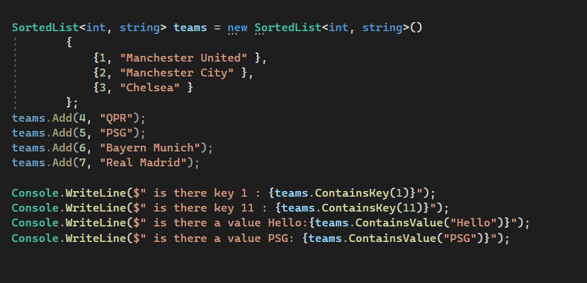
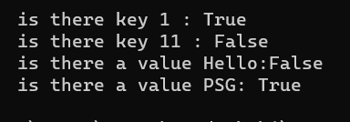

Slide 11
Properties of Generic SortedList Collection Class
Count: It returns the number of key/value pairs contained in the Generic SortedList collection.
Comparer: It returns the System.IComparable to the current Generic SortedList object.
Capacity: It is used to get or set the number of elements that the Generic SortedList can contain. It returns the number of elements that the Generic SortedList can contain.
Keys: It returns a collection containing the keys in the Generic SortedList in sorted order.
Values: It returns a collection containing the values in the Generic SortedList.

Slide 12
What are the differences between SortedList<TKey, TValue> and SortedDictionary<TKey, TValue>
The SortedList<TKey, TValue> collection uses less memory than SortedDictionary<TKey, TValue> collection.
The SortedDictionary<TKey, TValue> collection has faster insertion and removal operations for unsorted data compared to the SortedList<TKey, TValue> collection.
If the elements are populated all at once from sorted data then SortedList<TKey, TValue> collection works faster than SortedDictionary<TKey, TValue> collection.
The SortedList supports efficient indexed retrieval of keys and values which is not supported by SortedDictionary.
SortedList<TKey, TValue> collection doesn’t allow inserting the null value and duplicate value. Every key in a SortedList must be unique otherwise it throws ArgumentException. But it is possible to allow null and duplicate values in SortedDictionary<TKey, TValue> collection.

Slide 13
Generic SortedList<TKey, TValue> Collection Class Summary
The following are the important points that need to remember about the sorted list in c#.
The Generic SortedList Collection is used to store a collection of key/value pairs sorted by key based on the associated IComparer<T> implementation.
The Generic SortedList Collection allows us to store duplicate values, but keys must be unique to identify the values in the sorted list. Further, the key cannot be null but the value can be null for a reference type.
You can access Generic SortedList Elements either by using keys or with for and for each loop. In the for-each loop, we need to use KeyValuePair<TKey, TValue> to get key/value pairs from SortedList.

